Slide 1
Principal component analysis
PCA - reduce the number of variables of a data set, while preserving as much information as possible

Slide 2
PCA
Dimensionality reduction technique to help represent data in lower dimensions
Helpful in visualizations and modeling
Naturally comes at the expense of accuracy
The goal is to transform high-dimensional datasets (having a large number of features) into a low-dimensional one (having a smaller number of features) without losing too much information.
Datasets can include images or simple structured datasets.
Deal with the curse of dimensionality, which results in complex models and difficulty in visualizing.
Helps us to remove the Multi-collinearity situation in which some input features are correlated with each other and provide redundant information.

Slide 3
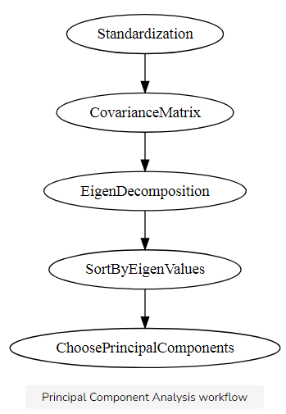
How PCA WORKS

Slide 4
Pca sTEPS
Standardize the range of continuous initial variables
Compute the covariance matrix to identify correlations
Compute the eigenvectors and eigenvalues of the covariance matrix to identify the principal components
Create a feature vector to decide which principal components to keep
Recast the data along the principal components axes

Slide 5
STEP 1: STANDARDIZATION
Standardize the range of the continuous initial variables
Variables with larger ranges will dominate over those with small ranges
Could lead to biased results
After normalization, all the variables will be transformed to the same scale.

Slide 6
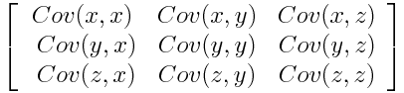
STEP 2: COVARIANCE MATRIX COMPUTATION
The goal of this step is to understand that if there is any relationship between input variables
Correlated variables = redundant information
We’ll use covariance matrix to identify these correlations
p × p symmetric matrix (where p is the number of dimensions)
Covariance matrix is a 3×3 matrix of this from

Slide 7
Cont.
Covariance of a variable with itself is its variance (Cov(a,a)=Var(a))
Thus main diagonal (Top left to bottom right) we actually have the variances of each initial variable
Covariance is commutative (Cov(a,b)=Cov(b,a)),
Means that the upper and the lower triangular portions are equal.

Slide 8
Cont.
Sign of the covariance matters:
If positive then: the two variables increase or decrease together (correlated)
If negative then: one increases when the other decreases (Inversely correlated)

Slide 9
STEP 3: COMPUTE THE EIGENVECTORS AND EIGENVALUES OF THE COVARIANCE MATRIX TO IDENTIFY THE PRINCIPAL COMPONENTS
Eigenvectors and eigenvalues are the linear algebra concepts that we need to compute from the covariance matrix
Used to determine the principal components of the data.
Principal components are new variables that are constructed as linear combinations or mixtures of the initial variables.
Combinations are done in such a way that the new variables (i.e., principal components) are uncorrelated
Most of the information within the initial variables is squeezed or compressed into the first components.

Slide 10
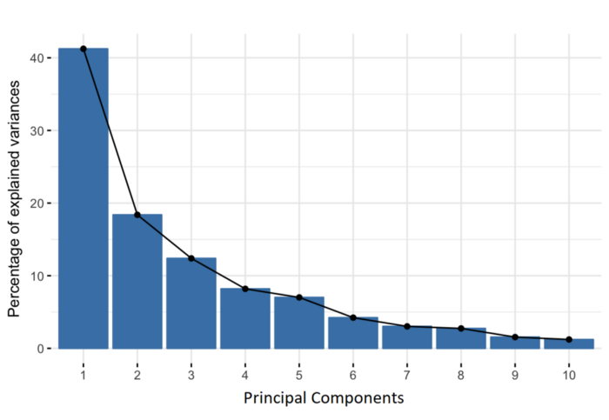
Scree plot
Notes:
idea is 10-dimensional data gives you 10 principal components, but PCA tries to put maximum possible information in the first component, then maximum remaining information in the second and so on, until having something like shown in the scree plot below
Organizing information in principal components this way, will allow you to reduce dimensionality without losing much information, and this by discarding the components with low information and considering the remaining components as your new variables.

Slide 11
Note that
Principal components are less interpretable and don’t have any real meaning since they are constructed as linear combinations of the initial variables.
Geometrically, principal components represent the directions of the data that explain a maximal amount of variance.
In simple terms, lines that capture most information of the data
Notes:
The relationship between variance and information here, is that, the larger the variance carried by a line, the larger the dispersion of the data points along it, and the larger the dispersion along a line, the more information it has. To put all this simply, just think of principal components as new axes that provide the best angle to see and evaluate the data, so that the differences between the observations are better visible.

Slide 12
How PCA Constructs the Principal Components
There are as many principal components as there are variables in the data
First principal component accounts for the largest possible variance, and so on.
Notes:
For example, let’s assume that the scatter plot of our data set is as shown below, can we guess the first principal component ? Yes, it’s approximately the line that matches the purple marks because it goes through the origin and it’s the line in which the projection of the points (red dots) is the most spread out. Or mathematically speaking, it’s the line that maximizes the variance (the average of the squared distances from the projected points (red dots) to the origin). The second principal component is calculated in the same way, with the condition that it is uncorrelated with (i.e., perpendicular to) the first principal component and that it accounts for the next highest variance.
This continues until a total of p principal components have been calculated, equal to the original number of variables.

Slide 13
eigenvectors and eigenvalues
Comes in pairs, so that every eigenvector has an eigenvalue.
Their number is equal to the number of dimensions of the data
For example, for a 3-dimensional data set, there are 3 variables, therefore there are 3 eigenvectors with 3 corresponding eigenvalues.

Slide 14
Cont.
Eigenvectors of the Covariance matrix are actually the directions of the axes where there is the most variance(most information) and that we call Principal Components.
Eigenvalues are simply the coefficients attached to eigenvectors, which give the amount of variance carried in each Principal Component.
By ranking eigenvectors in order of their eigenvalues, highest to lowest, you get the principal components in order of significance.

Slide 15
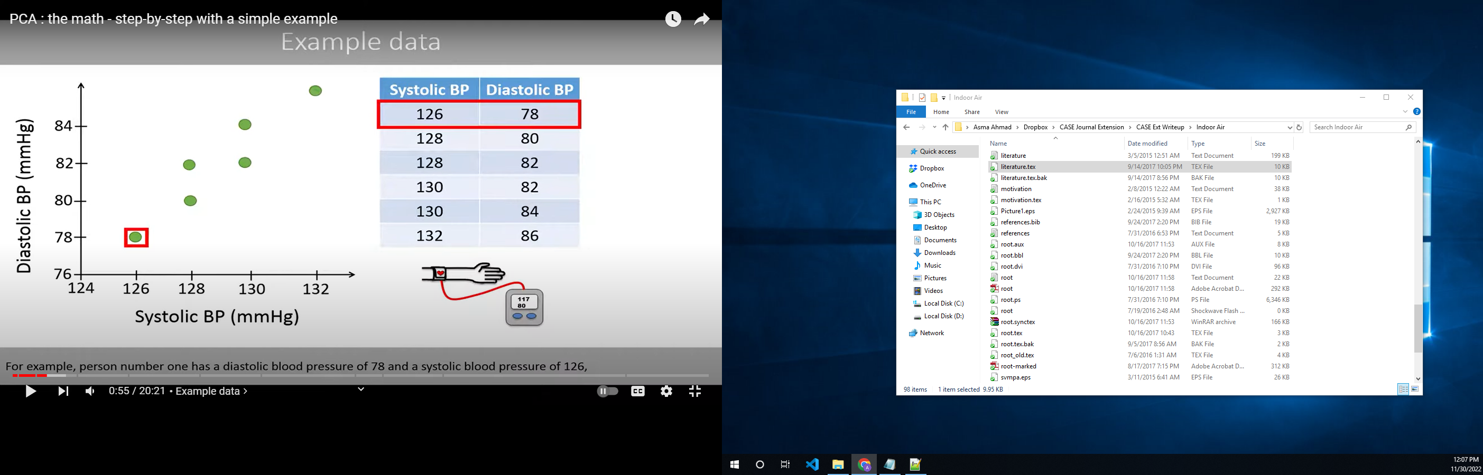
Data and scatter plot

Slide 16
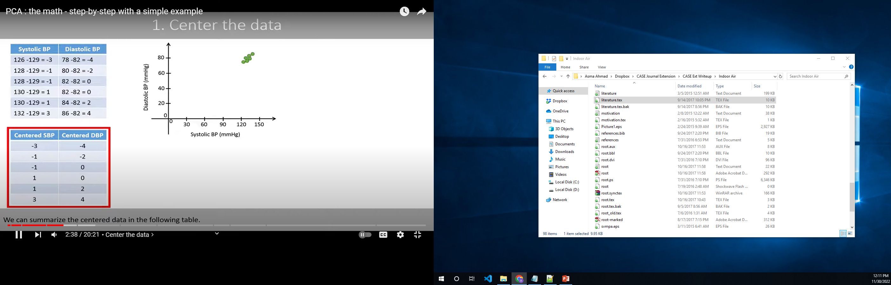
Subtracting mean

Slide 17
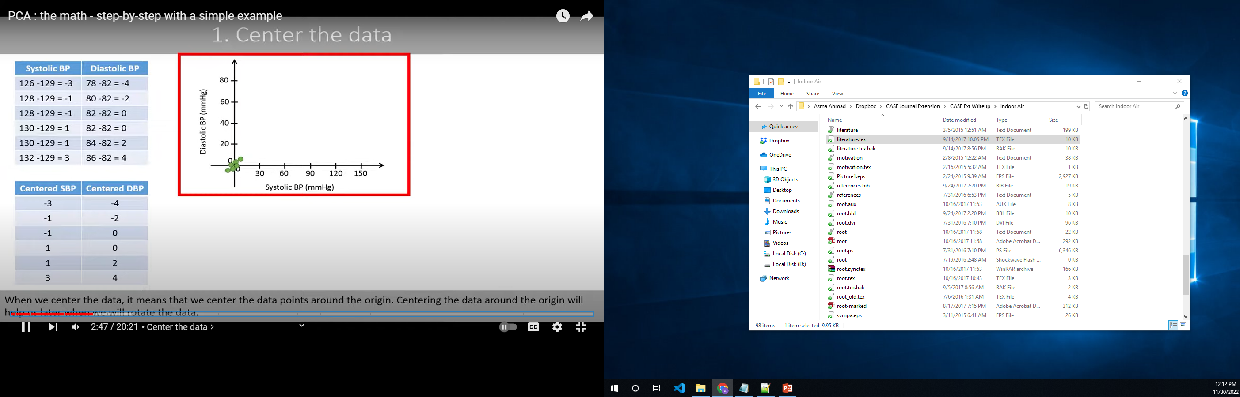
Cont.

Slide 18
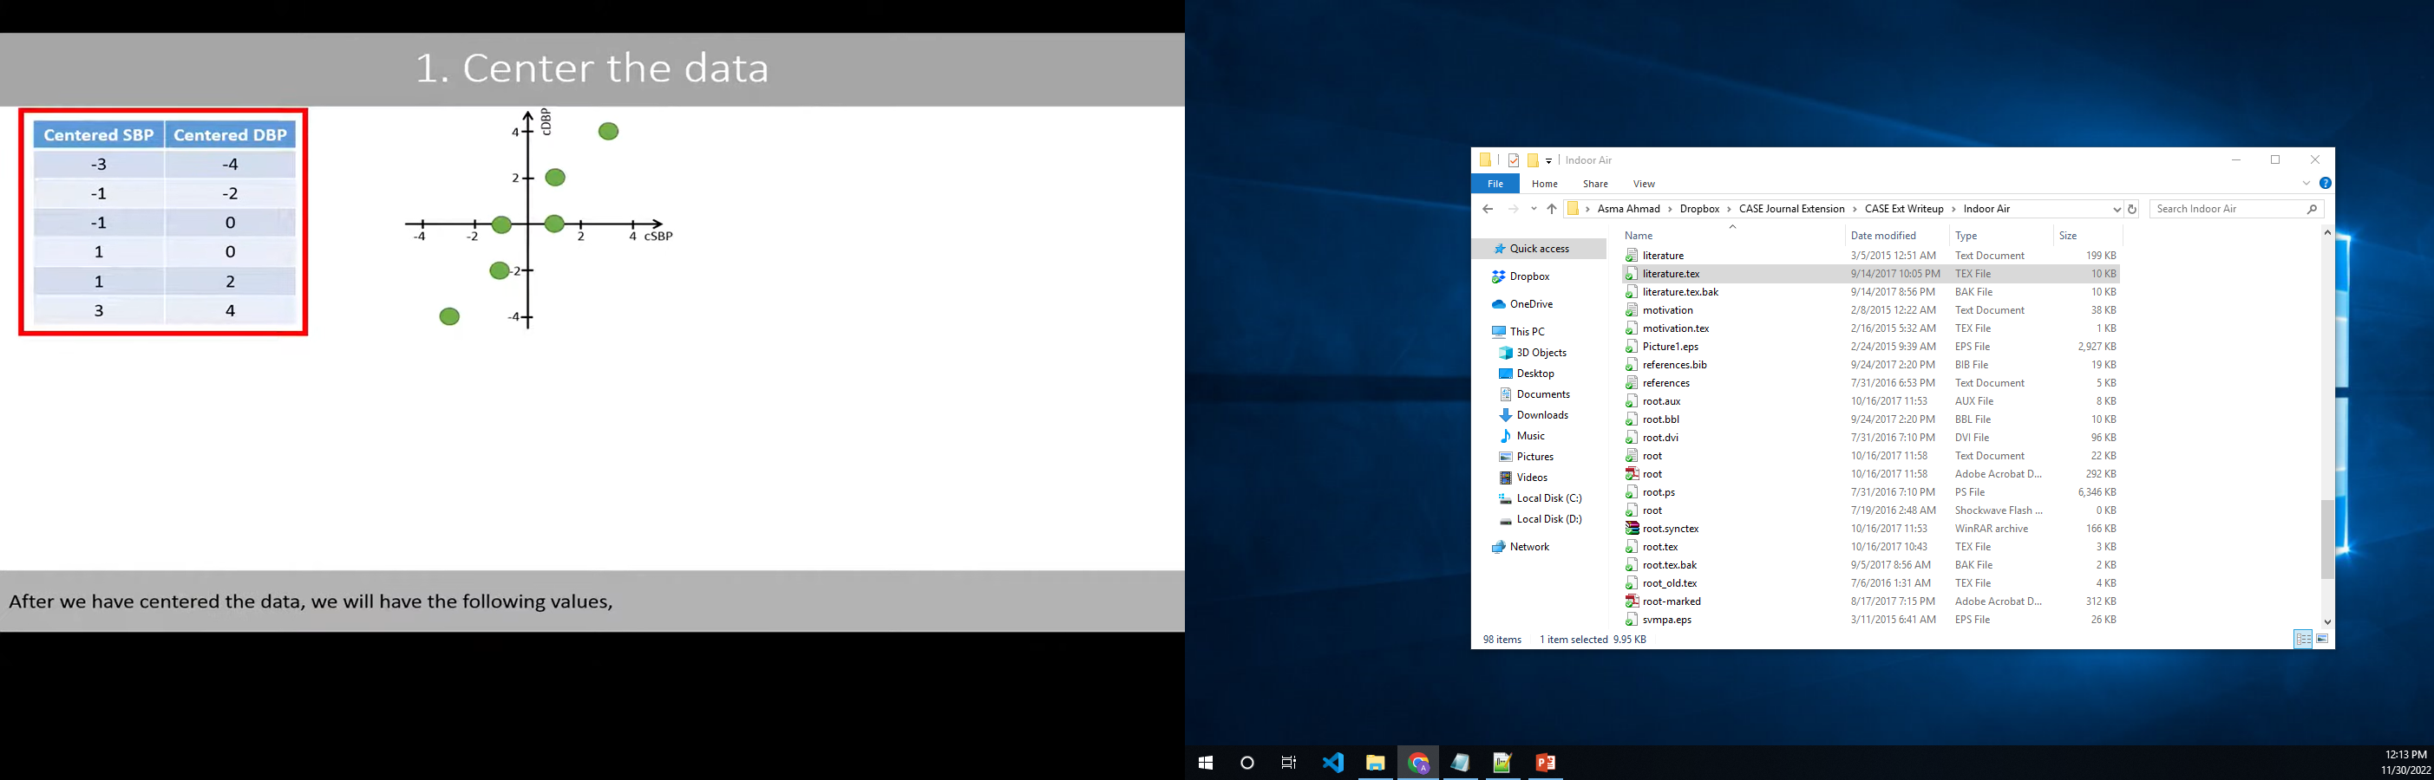

Slide 19
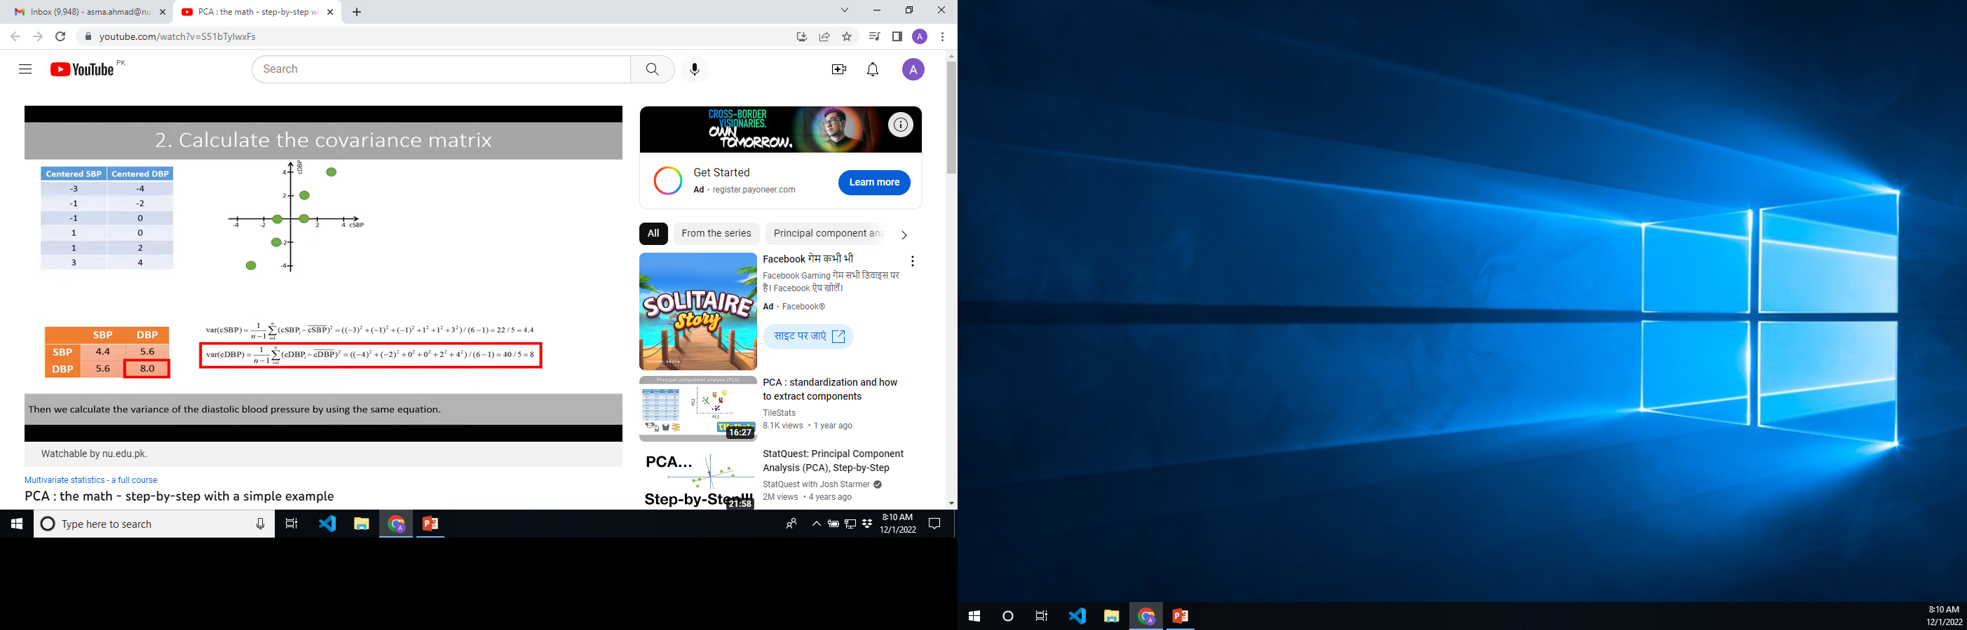
Covariance Matrix

Slide 20
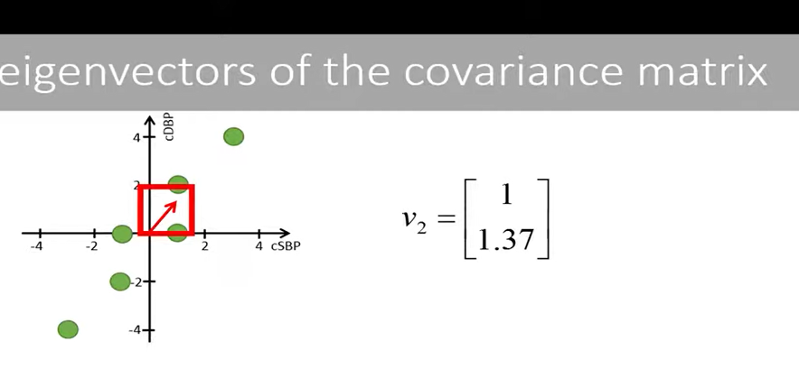
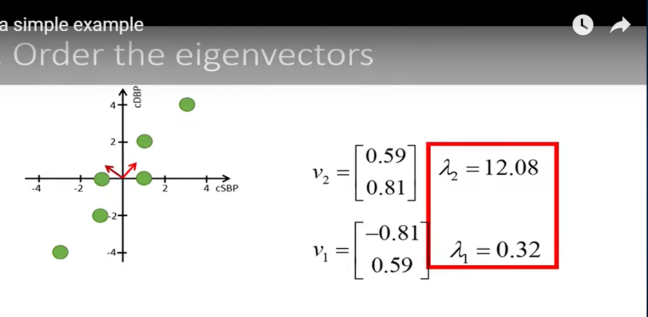

Slide 21
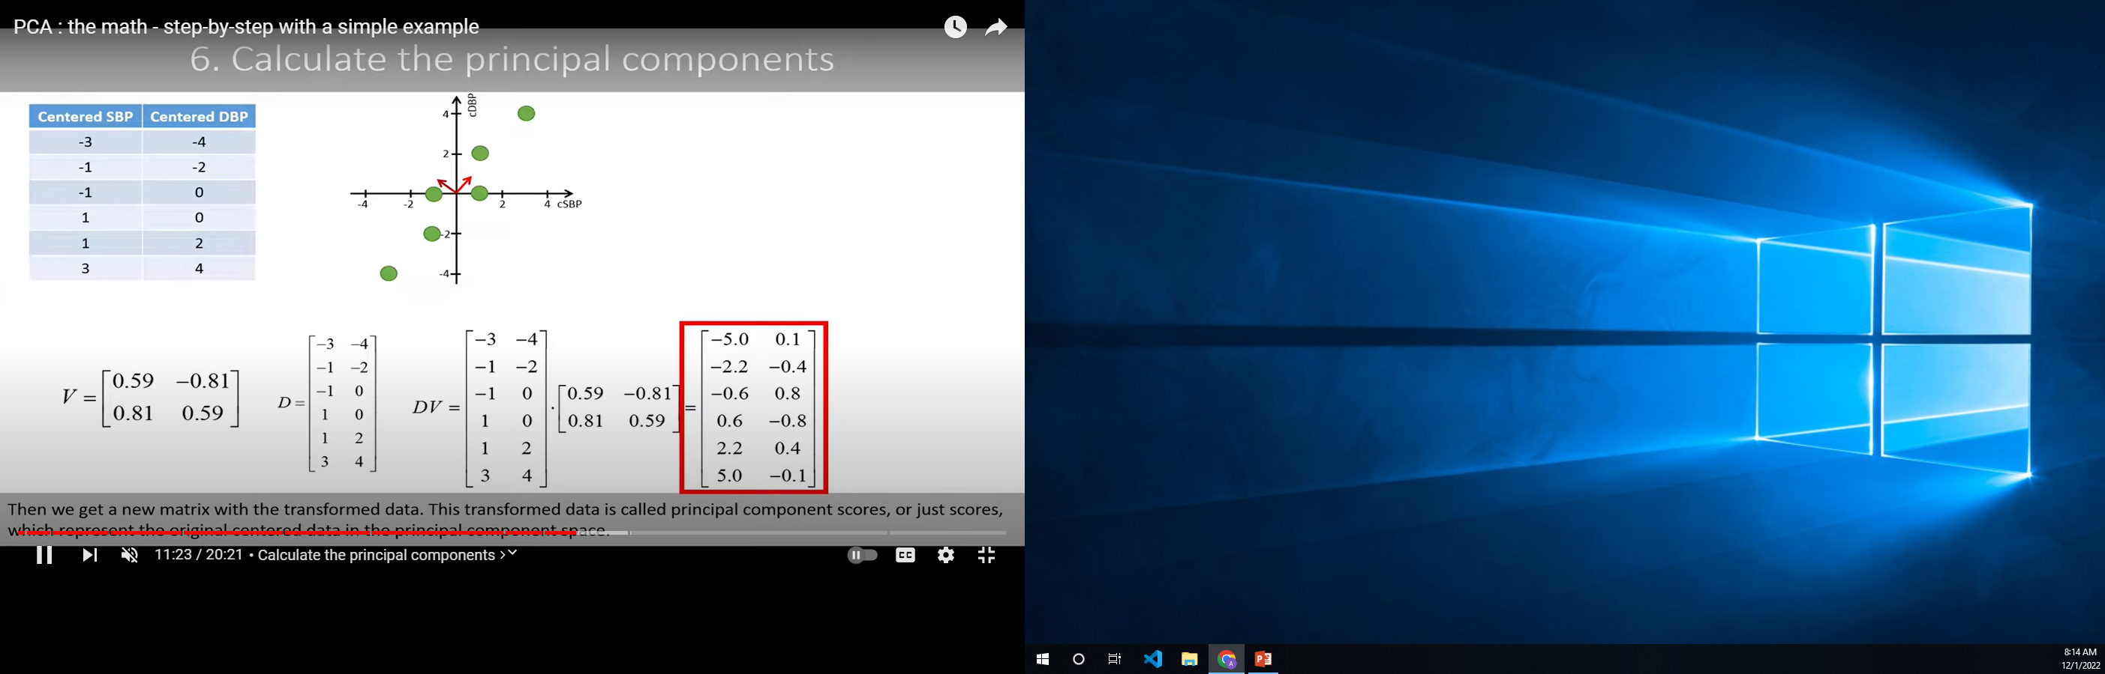
PC Caluclation

Slide 22
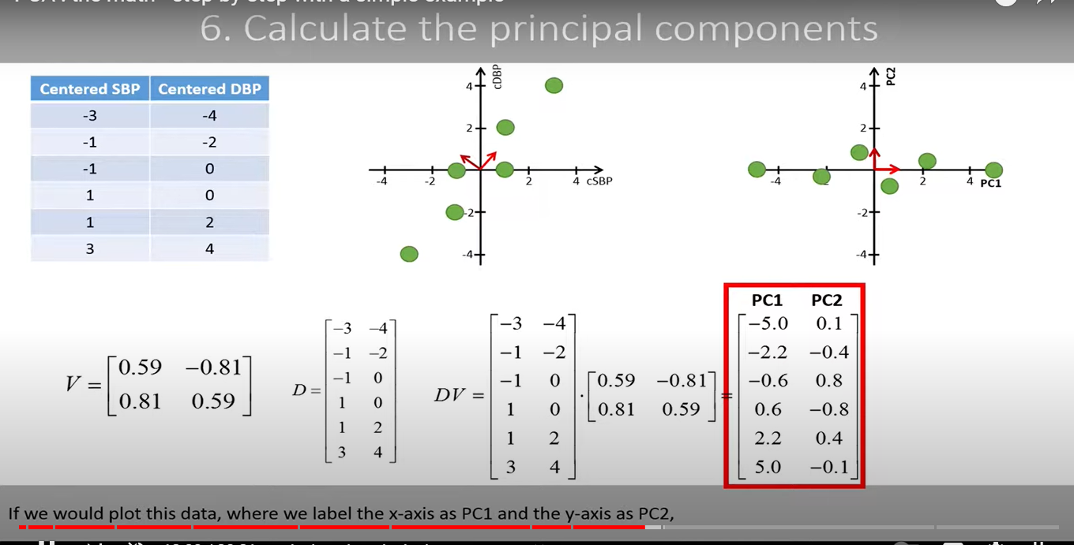
Cont.

Slide 23
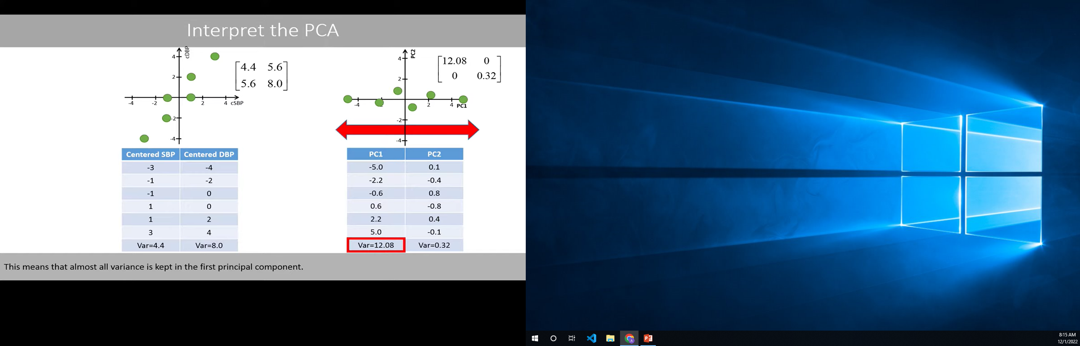
Interpret the pca

